Slide 1


Style Transfer: From Sketch to Reality
Explore the exciting world of style transfer! Discover how AI transforms simple sketches into realistic images. This presentation covers techniques, examples, and future possibilities.
2210030438: Advith 2210030417: Shashank 2210030125: Harshith 2210030454: Dushyanth

Slide 2
What is Style Transfer and How Does it Work?
Style transfer uses deep learning to apply the style of one image to another. It separates content from style, recombining them to create new images.
Content
Style
The structural elements of the original drawing.
Color palettes, textures, and artistic properties.

Slide 3
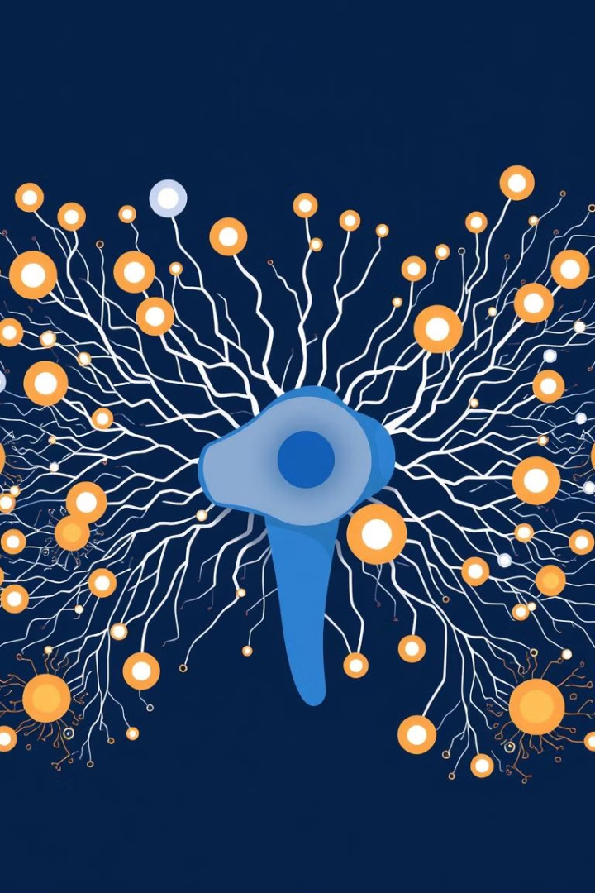




The Magic Behind Image Transformation
Convolutional Neural Networks (CNNs) analyze images. They extract features like edges, textures, and object shapes. This enables style and content to be transferred effectively.
Feature Extraction
CNNs identify key elements.
Style Analysis
Determine artistic properties.
Content Mapping
Match elements.
Reconstruction
Generate new images.

Slide 4
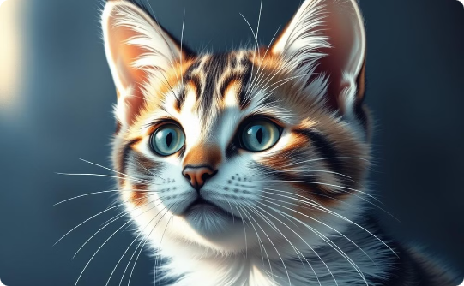
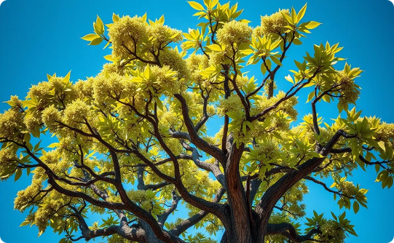
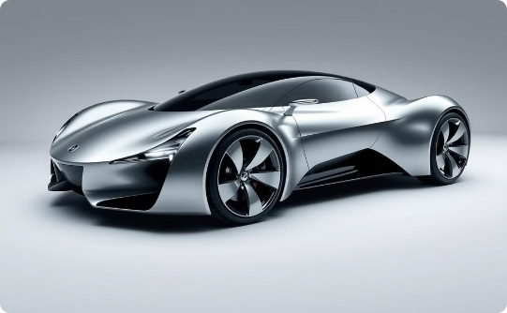
Examples: Simple Drawings Transformed
See how basic sketches become detailed, realistic images. These examples show the power of AI style transfer. Watch imagination take real form!
Cat
Tree
Car
From doodle to adorable feline.
A sketch comes to life.
Rough becomes road-ready.

Slide 5

Case Study 1: Landscapes and Architecture
Transforming landscape sketches into breathtaking scenes. Architectural drawings become photorealistic buildings. Experience the stunning realism!
1
Sketched Mountains
2
Simple Houses
3
City Skylines
Become majestic peaks with snow.
Evolve into detailed homes with gardens.
Transform into vibrant urban landscapes.

Slide 6

Conclusion: Unleashing Creativity with AI
Style transfer unlocks new possibilities. AI bridges the gap between imagination and reality. Explore your creative potential today!
Accessibility
Innovation
Imagination
Easy to use tools.
Endless creativity.
Sketch and see.

